Slide 1

On the Probabilistic Symbolic Analysis of Software
Corina Pasareanu
CMU-SV
NASA Ames

Slide 2

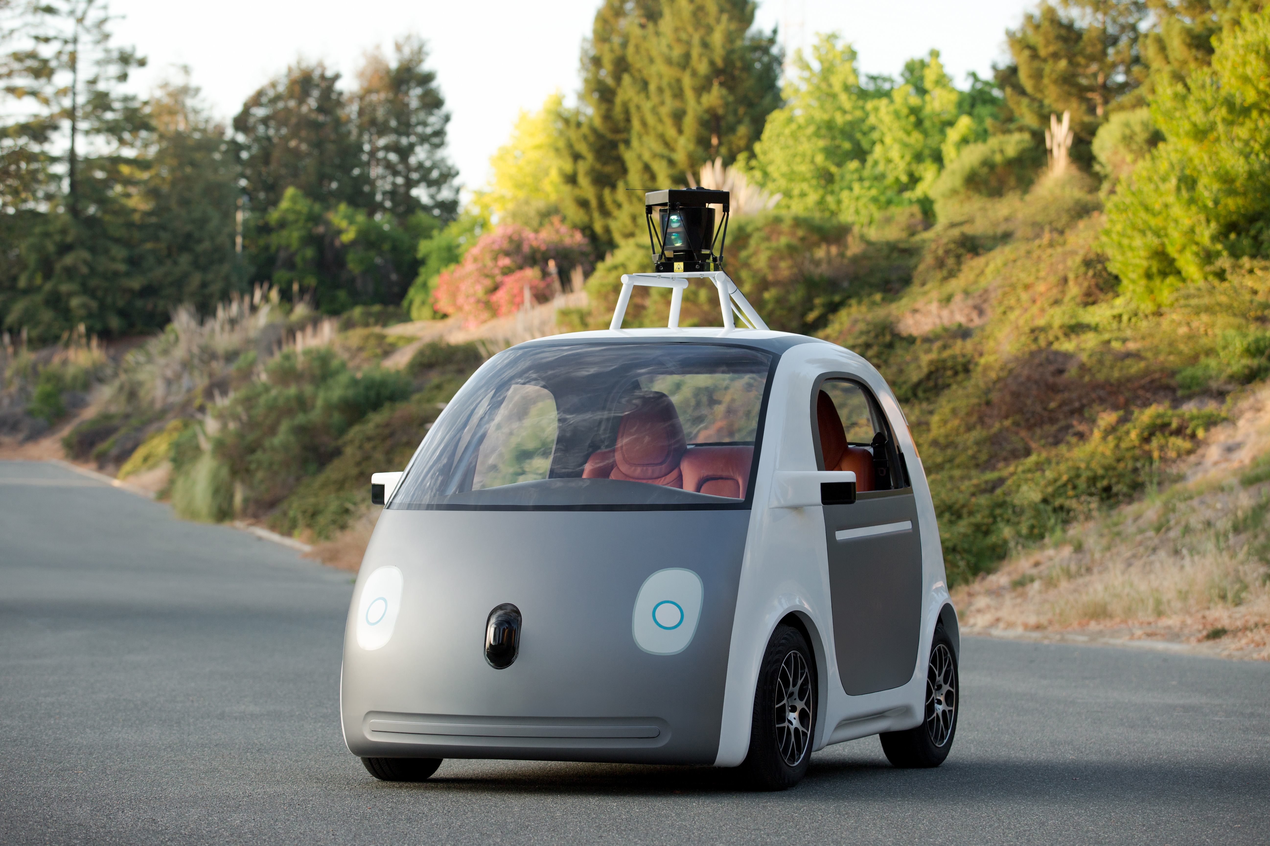
Probabilistic Symbolic Execution
Quantifies the likelihood of reaching a target event
e.g., goal state or assert violation
under uncertainty conditions from the environments
Example
check that the probability of an unmanned aerial vehicle turning too fast is less than 10^-6
analyze the vehicle's control software
under suitable probabilistic profiles built from the telemetry data of hundreds of hours of operation from previous versions or similar systems
Simulation
traditionally used
very expensive
Probabilistic symbolic execution
complements simulation
for increased assurance at reduced cost

Slide 3
Probabilistic Software Analysis
Traditional approaches are based on probabilistic model checking, e.g. PRISM
Models
difficult to maintain
abstract away details that impact chances of executing target events
We aim to perform the analysis at code level

Slide 4
Probabilistic Software Analysis
Traditional approaches are based on probabilistic model checking, e.g. PRISM
Models
difficult to maintain
abstract away details that impact chances of executing target events
We aim to perform the analysis at code level

Slide 5
Probabilistic Symbolic Execution
Bounded symbolic execution
generates symbolic constraints over program paths
Quantification procedure, e.g., model counting
quantifies the probability of satisfying the constraints
when target event (success or fail) reached or bound reached, estimate the number of inputs that satisfy the conditions to reach that event
Applications
Computing reliability: when software is involved in contributing to a system-level event
Analysis of cyber-physical systems
Quantitative information flow analysis for security
Program understanding and debugging
Certification …

Slide 6
Probabilistic Symbolic Analysis
UP
Program
Sym Exe
PCs
Probability
Computation
Pr_{success}
Pr_{fail}
Pr_{grey}

Slide 7
Usage Profiles
what are they?
probabilistic characterizations of software interactions with external environment
users, physical world, other components
assign to each valid combination of inputs the probability to occur during execution
<c₁,p₁> <c₂,p₂> …
who creates them?
monitoring usage of previous versions/similar systems
expert/domain knowledge
physical phenomena, e.g. wind effect
we assume they are given

Slide 8
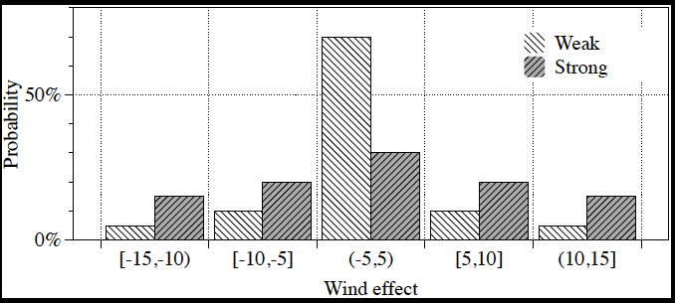
Example Usage Profile
Arbitrary UPs – handled through discretization
UPs can be seen as “pre-conditions”

Slide 9
Example
// domain of x is [0..100]
public static void test(int x){
if(x > 50)
x++;
if(Verify.getBoolean()) { //T1
if(x > 61)
println("success");
else
assert false;
} else { //T2
if(x <= 81)
println("success");
else
assert false;
}
}
x>50
(0.5)
0
x≤50
(0.5)
1
2
T1
T2
T1
T2
x>50&
x>60
(0.8)
3
x>50&
x≤60
(0.2)
4
x>50&
x≤80
(0.4)
5
6
x>50&
x>80
(0.6)
x≤50&
x≤80
(1)
x≤50&
x≤60
(1)
Succ.
0.4
Fail
0.1
Succ.
0.3
Fail
0.2
Fail
0.5
Succ.
0.5
Scheduler: resolves non-deterministic choices to maximize probability of success

Slide 10
Example
x>50
(0.5)
0
x≤50
(0.5)
1
2
T1
T2
T1
T2
x>50&
x>60
(0.8)
3
x>50&
x≤60
(0.2)
4
x>50&
x≤80
(0.4)
5
6
x>50&
x>80
(0.6)
x≤50&
x≤80
(1)
x≤50&
x≤60
(1)
Succ.
0.4
Fail
0.1
Succ.
0.3
Fail
0.2
Fail
0.5
Succ.
0.5
Max: Pr_{success} =0.9

Slide 11
Statistical Symbolic Execution
Approximate algorithms
Monte-Carlo sampling of symbolic paths based on conditional probabilities in the symbolic execution tree
Reinforcement learning to iteratively computing schedulers
Pruning of already explored paths
Comparison with classical Monte-Carlo simulation
For each explored path
We compute the full count associated with the PC; we need to explore each path only once; our approach enables aggressive pruning
Simulation needs to sample many many times along the same paths to achieve the desired confidence
Usage profiles
Summarize hundreds of hours of operation/simulation

Slide 12
Summary
White-box methodology for finite domains using model counting, with explicit measure of confidence [ICSE 2013]
Dealing with floating-point numbers and arbitrarily complex constraints [PLDI 2014]
Statistical techniques for increased scalability [FSE 2014]
Synthesis of tree-like schedulers for multithreading [ASE 2014]
Improved support for data structures

Slide 13
Future Work
Infer usage profiles from telemetry data
Compute admissible input distributions to guarantee certain probabilistic safety properties
ACASX: airborne collision avoidance system
So far we have studied memory-less schedulers
May not be enough for computing maximal properties for bounded properties
History dependent schedulers are more powerful
Parallel sampling
Preliminary implementation
Some overhead due to thread contention
Reduce analysis time by 30%

Slide 14
Collaborators
Antonio Filieri (University of Stuttgart, Germany)
Kasper Luckow (Aalborg University, Denmark)
Willem Visser and Jaco Geldenhuys (University of Stellenbosch, South Africa)
Marcelo d'Amorim and Mateus Borges (Federal University of Pernambuco, Brazil)
Matt Dwyer (University of Nebraska, Lincoln, USA)
http://ti.arc.nasa.gov/profile/pcorina/probabilistic/

Slide 15
“Rare event”
// domain of x is [0..100]
void testMethod (int x) {
if (Verify.getBoolean()) {
if (x < 2) {
... println(" success ");
return ;
} else {
if (Verify.getBoolean())
if (Verify.getBoolean())
... // repeat 500 times
if (x > 5) {
... println(" success ");
return ;
}
}
}
assert false ;
}
Pr_{success} =0.96
Hard to compute with approximate techniques
Pruning helps

